Slide 1
Process Modelling

Slide 2

BPM lifecycle and roles
BPM group
System admin/operations team
Process owner
Analyst
Process participants
Developer

Slide 3

Process identification
What?
Identify an organization’s business processes
Prioritize their management based on certain criteria
Why?
Understand the organization
Maximize value of BPM projects
Notes:
Systematically define…
Establish clear criteria to…, i.e. for modelling, analysing, redesigning, automating and monitoring processes
Boundaries, i.e. the scope of each process with respect to the other processes
Process identification is a set of activities aiming to systematically define the set of
business processes of a company and establish clear criteria for prioritizing them.
The main output of process identification is a process architecture, which represents the
business processes and their interrelations. A process architecture serves as a framework
for defining the priorities and the scope of process modeling and redesign
projects.
WHY PROCESS IDENTIFICATION?
The first reason, related to the first aim, is UNDERSTANDING (the very first value we generate with BPM – transparency. And identification is the first step towards achieving that). The second reason, related to the second aim, is BUDGET, or better VALUE FOR MONEY.
Few organizations have the resources required to model all their processes in detail, to rigorously analyze and redesign each of them, to deploy automation technology in order to support each of these processes, and finally to continuously monitor the performance of all processes in detail. Even if such resources were available, it would not be cost-effective to spend them in this way. BPM is not free. Like any other investment in a company, investments in BPM have to pay off. Thus, it is imperative in every organization engaged in BPM to focus the attention on a subset of processes, i.e. to prioritize.
REASONS FOR PRIORITIZING
Some processes need to receive priority because they are of strategic importance to an organization’s survival. Other processes might show striking problems, which should be resolved for the sake of all involved stakeholders. In other words, the processes that an organization should focus on are found in areas where there is either great value created or significant trouble present (or both). To make things more complex, the subset of high-priority processes in an organization is subject to the dynamics of time: what may be processes that are of strategic importance to an organization at some point may grow less important as time elapses. Market demands may change and new regulations or the introduction of new products may limit what was once a profitable business activity. For example, the arrival of new competitors offering discount insurance policies through Web-based channels may push an established company to redesign its insurance sales processes to make them leaner, faster, and accessible from the Web.
However, while some processes may be problematic at one point, once the issues have been identified and resolved by a process improvement project, an organization can do with only periodic inspections for some time. For example, an insurance company suffering from high levels of customer dissatisfaction will naturally tend to focus on its customer-oriented processes, say its claims handling process. Once this process has improved and customer satisfaction is again within the desired range, the emphasis might move to its risk assessment processes, which are important for the long-term viability and competitiveness of the company.

Slide 4
Process identification steps
Designation step
Enumerate main processes
Determine process scope
Prioritization step (aka Process selection)
Prioritize processes based on:
Importance
Health
Feasibility
Process Architecture
Prioritized Process Portfolio
After Davenport (1993)
Notes:
Scope = the area of ​​action, in particular what are the interrelationships both in order and in hierarchy between the processes under examination and other processes in existence in the organization
Feasibility = predisposition of these processes to be improved. Here cultural and political aspects must be taken into consideration
Designation phase: what processes are executed in our organization
Boundaries and interrelationships = process scope
Prioritization (aka Evaluation phase, aka Process Selection): based on this information, which processes should the organization focus on in terms of management activities (modelling, redesign, automation, monitoring)?
Process scope : boundaries and interrelationships
Culture, e.g. the participants of a particular process are negatively affected by the way they are mandated to perform a given process (e.g. a suboptimal way), and start deviating from that
Importance
Which processes have the greatest impact on the organization‘s strategic goals?
Dysfunction
Which processes are in the deepest trouble?
Feasibility
Which process is the most susceptible to successful process management?
The evaluation can be carried out through a process portfolio diagram
The second point is about the health of a process. Which processes perform the worst? Which ones are less conformant with policies and regulations? Which ones are the less suistainable?
The third point is related to the susceptibility of a process to incidental or continuous process management initiatives, i.e. redesign, automation etc. BPM should focus on those processes where it is reasonable to expect benefits

Slide 5
Example: prioritized process portfolio
Financial institution
Short-term action
High
Rating
Feasibility
Loan
controlling
Contract
preparation
Low
Loan
decision
Medium
Loan market
evaluation
High
Importance
Handling of
payments
Loan
planning
Loan
application
Low
Poor
Possible
Health
Strategic fit?
Good
Notes:
Possible = potential for outsourcing, esp. those that cannot be easily changed, such as handling of payments. Note, they are strategically not very important
Importance
Dysfunction
Feasibility = For each process, it should be determined how susceptible they are to process management initiatives, either incidental or on a continuous basis. Most notably, culture and politics involved in a particular process may be obstacles to achieve results from such initiatives. In general, process management should focus on those processes where it is reasonable to expect benefits. [CULTURE & PEOPLE]
Clearly, the three aspects of importance, dysfunction and feasibility are fully orthogonal.
3 messages:
Not too many projects in parallel because it’s too costly (time, resources)
Not too many projects in parallel because of increased coordination complexity (processes are interrelated)
Don’t tackle for first the process that is the most strategically important and dysfunctional, because you will have high chances of failure. Rather, start with a small number of projects as Davenport say, and learn from these
Should all processes that are dysfunctional, of strategic importance, and feasible to manage be subjected to process management initiatives?
The general answer to this question is that for most organizations this is not feasible. Recall again that process management consumes resources. Even when there is a clear incentive to, for example, redesign various existing business processes, most organizations lack sufficient resources—people, funds, and time—to do so. Only the largest organizations are able to support more than a handful of process improvement projects at the same time. A good case in point is IBM, an organization known to have process improvement projects going on within all its existing business processes on a continuous basis. Another caveat of carrying out many simultaneous process management efforts is that these will create coordination complexity. Remember that processes may be linked to each other in various respects, such that measures taken for one process should be synchronized with those taken for other. As Davenport [10] describes: Most companies choose to address a small set of business processes in order to gain experience with innovation initiatives, and they focus their resources on the most critical processes. Each successful initiative becomes a model for future efforts.
What is happening in some organizations is that widespread efforts are made to at least model all important business processes, delaying the decision to make the step to more advanced BPM efforts (e.g. process redesign or automation). The idea is that process models are a cornerstone of any further BPM efforts in any case and that their existence will help to better understand where improvements can be gained. Creating a model of a process leads to the valuable insight how that process works at all, and can provide a good basis for small improvements that can easily be implemented. On the downside, such an approach bears the risk that major improvements are missed and stakeholders develop a feeling of a lack of return for the efforts. It should be stressed here, too, that the actual modeling of business processes is not an element of the process identification stage.
---
Note that it may very well be that a strategically important process is also the process that can be expected to be the most difficult one to manage, simply because so many earlier improvement efforts have already failed. An organization may not have a choice in such a situation. If a strategic process cannot be improved, this may turn out to be fatal for an organization as a whole. Think of a situation where the process to come up with new products creates much turmoil and conflicts within an organization: If the issues cannot be sorted out, the company may stop functioning quickly. In other settings, it may be more important to gain credibility with process management activities first. This can be accomplished by focusing on problematic processes of milder strategic importance but where there is a great desire to change. If successful, an improvement project at such a place may give credibility to the process management approach. These are not choices that can be easily prescribed without taking the specific context into situation. The various evaluation outcomes should be balanced to reach a list of those processes that should receive priority over others.

Slide 6
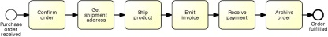
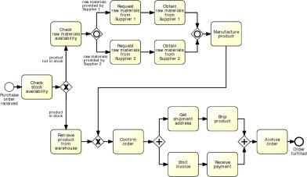
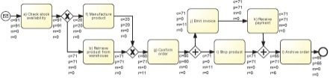

Slide 7
Purposes of process modeling
Communication
Documentation
Analysis (e.g. simulation)

Slide 8

Business Process Model and Notation (BPMN)
OMG standard
Suitable for capturing models for process discovery, analysis, and implementation
Supported by numerous tools
Notes:
To model our business processes, we will use the BPMN language. BPMN stands for Business Process Model and Notation,
BPMN 1.0 specification released in May 2004, Put forward as a standard proposal in Feb 2006, BPMN 2.0 released in Jan 2011
There’s a strong industry push for using BPMN, with over 70 tools supporting the standard
Bizagi Process Modeller (free)
Signavio (http://www.signavio.com/) - subscription
For academic purposes: http://academic.signavio.com
Oracle BPA – “kind of free”
ARIS – very sophisticated but the opposite of free
Logizian – reasonable tradeoff
MS Visio – You might already have this

Slide 9
BPMN from 10,000 miles…
A BPMN process model is a graph consisting of four types of core elements:
start
end
activity
event
gateway
sequence flow
Notes:
Slide notes: as per previous slide (LR)

Slide 10
Let’s start modeling
Order-to-cash
An order-to-cash process is triggered by the receipt of a purchase order from a customer. Upon receipt, the purchase order has to be checked against the stock to determine if the the requested item(s) are available. Depending on stock availability the purchase order may be confirmed or rejected.
If the purchase order is confirmed, an invoice is emitted and the goods requested are shipped. The process completes by archiving the order.

Slide 11
Let’s start modeling – break it down
Order-to-cash
An order-to-cash process is triggered by the receipt of a purchase order from a customer.
Upon receipt, the purchase order has to be checked against the stock to determine if the the requested item(s) are available.
Depending on stock availability the purchase order may be confirmed or rejected.
If the purchase order is confirmed, an invoice is emitted and the goods requested are shipped. The process completes by archiving the order.

Slide 12
Let’s start modeling – break it down
Order-to-cash
An order-to-cash process is triggered by the receipt of a purchase order from a customer.
Upon receipt, the purchase order has to be checked against the stock to determine if the the requested item(s) are available.

Slide 13
BPMN Model
Order-to-cash
Notes:
Start event: trigger
End event: process outcome
Split gateway: this is where the control flow is split into two or more branches. In this case the flow is split into two mutually exclusive branches (one taken when items are not in stock, the other when the items are in stock).
Talk about triggers and outcomes: this process has one trigger and two possible outcomes. Without reading the content, I can already see this process can end up in an order being fulfilled (which in this case is a positive outcome) or rejected (negative outcome)
Clearly, for the organization running this process, like a seller or supplier, the goal is to fulfil the order, so that value can be generated for the customer who submitted the order.
It is important to ensure consistency across all our models. One way of doing this is to establish some conventions for labelling events and activities.

Slide 14
Let’s start modeling – break it down
Order-to-cash
An order-to-cash process is triggered by the receipt of a purchase order from a customer.
Upon receipt, the purchase order has to be checked against the stock to determine if the the requested item(s) are available.
Depending on stock availability the purchase order may be confirmed or rejected.
If the purchase order is confirmed, an invoice is emitted and the goods requested are shipped. The process completes by archiving the order.

Slide 15
BPMN Model
Order-to-cash
end event
activity
split gateway
end event
start event
Naming conventions
Event: noun + past-participle verb (e.g. insurance claim lodged)
Activity: verb + noun (e.g. assess credit risk)
Notes:
Start event: trigger
End event: process outcome
Split gateway: this is where the control flow is split into two or more branches. In this case the flow is split into two mutually exclusive branches (one taken when items are not in stock, the other when the items are in stock).
Talk about triggers and outcomes: this process has one trigger and two possible outcomes. Without reading the content, I can already see this process can end up in an order being fulfilled (which in this case is a positive outcome) or rejected (negative outcome)
Clearly, for the organization running this process, like a seller or supplier, the goal is to fulfil the order, so that value can be generated for the customer who submitted the order.
It is important to ensure consistency across all our models. One way of doing this is to establish some conventions for labelling events and activities.

Slide 16
Execution of a process model The “token game”
Order #1
Order #2
Order #3
Notes:
One important notion we need to understand when creating process models is the difference between a process model and its process instances, or in other words, the difference between design-time and run-time. In order to understand this difference, we need to know more about start and end events.

Slide 17
A little bit more on events…
A start event triggers a new process instance by generating a token that traverses the sequence flow (“tokens source”)
An end event signals that a process instance has
completed with a given outcome by consuming
a token (“tokens sink”)
start
event
end
event

Slide 18
Order-to-cash example revisited…
[…] If the purchase order is confirmed, an invoice is emitted and the goods requested are shipped (in any order). The process completes by archiving the order. […]
Notes:
Clearly, we need to archive the order once both the emission of the invoice and the shipment of the goods have been done, but there’s nothing preventing us from emitting the invoice necessarily BEFORE shipping the goods. In other words, we are not concerned about the specific order in which these two activities can take place, so long as they are BOTH completed. I can first emit the invoice or ship the goods. Or event these two activities could start at the same time. Thus, we need to use gateways to model this condition.

Slide 19
First try
Order-to-cash
split
split
join
Notes:
What’s the problem with this solution?

Slide 20
A little more on gateways: XOR Gateway
An XOR Gateway captures decision points (XOR-split) and points where alternative flows are merged (XOR-join)
XOR-split ➔ takes one outgoing branch
XOR-join ➔ proceeds when one incoming branch has completed
Notes:
The term “Gateway” implies that there is a gating mechanism that either allows or disallows passage of tokens through the Gateway. As Tokens arrive at a Gateway, they can be split apart on output or merged together on input, as the Gateway mechanisms are invoked.
Decision points, where the flow is split between two or more alternatives,
With two inputs, XOR is true if and only if the inputs differ (one is true, one is false). With multiple inputs, XOR is true if and only if the number of true inputs is odd.

Slide 21
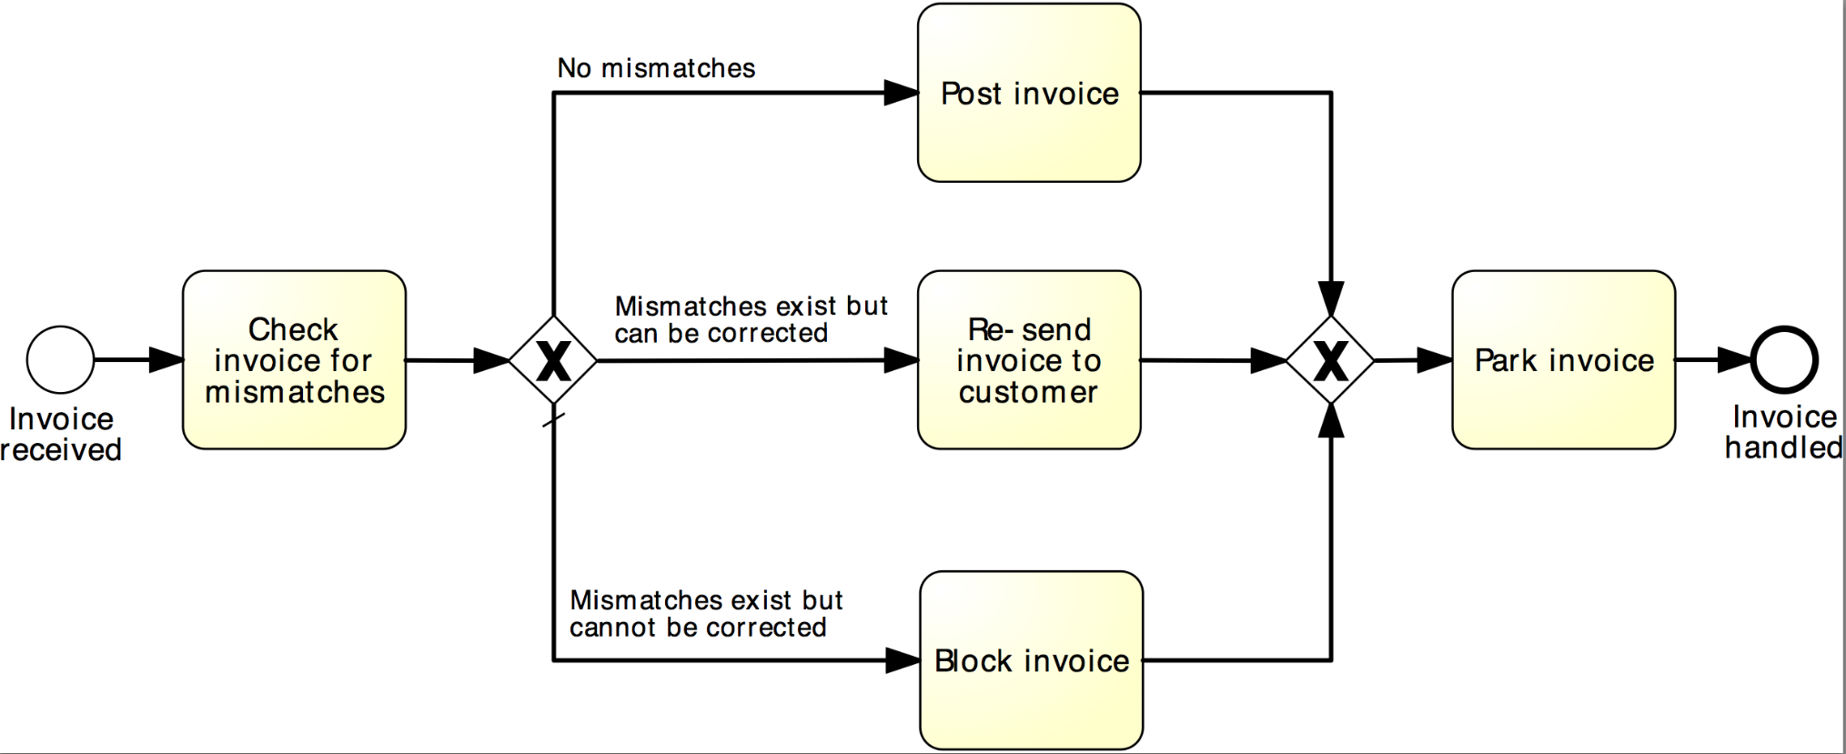
Example: XOR Gateway
Invoice checking process
Notes:
A default flow is the default branch to be chosen from an (X)OR-split if all other conditions evaluate to false

Slide 22
A little more on gateways: AND Gateway
An AND Gateway provides a mechanism to create and synchronize “parallel” flows.
AND-split ➔ takes all outgoing branches
AND-join ➔ proceeds when all incoming branches have completed
Notes:
By “parallel” we intend flows which can proceed independently of each other

Slide 23
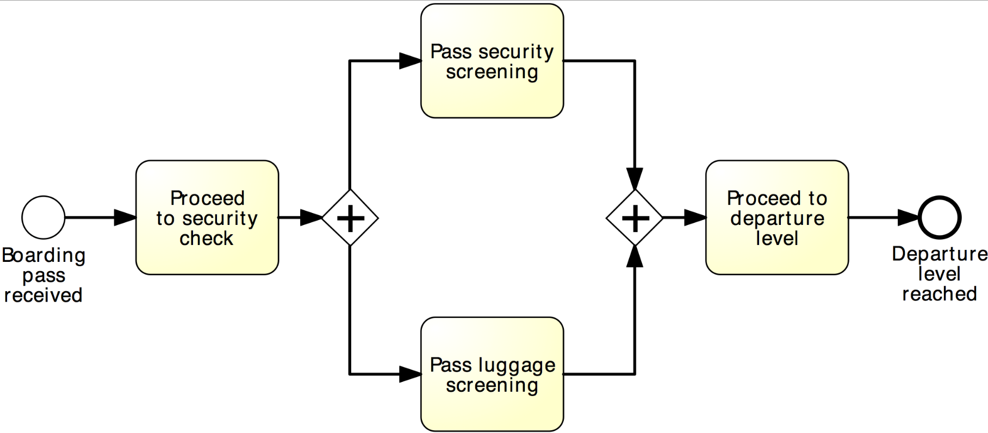
Example: AND Gateway
Airport security check
Notes:
Let’s take, as an example, the security check at an airport. Depending on the layout of the airport, on its passengers traffic at the moment we approach the security check, we may first pass through the security screening and then our luggage will pass through screening, or, for example, luggage screening may start first, and while this is being done, we quickly pass through security screening (as most often happens). However, in order to proceed to the departure level, we first have to pass both screenings: security and luggage

Slide 24
Revised order-to-cash process model
XOR-split
AND-split
AND-join
Notes:
So, coming back to our example, in order to disambiguate these gateways, and assigning a proper behavior to our model, we need to use…

Slide 25
Between XOR and AND
Order distribution process
A company has two warehouses that store different products: Amsterdam and Hamburg. When an order is received, it is distributed across these warehouses: if some of the relevant products are maintained in Amsterdam, a sub-order is sent there; likewise, if some relevant products are maintained in Hamburg, a sub-order is sent there. Afterwards, the order is registered and the process completes.
Notes:
Sometimes, the number of branches to be taken varies from one instance to another:

Slide 26
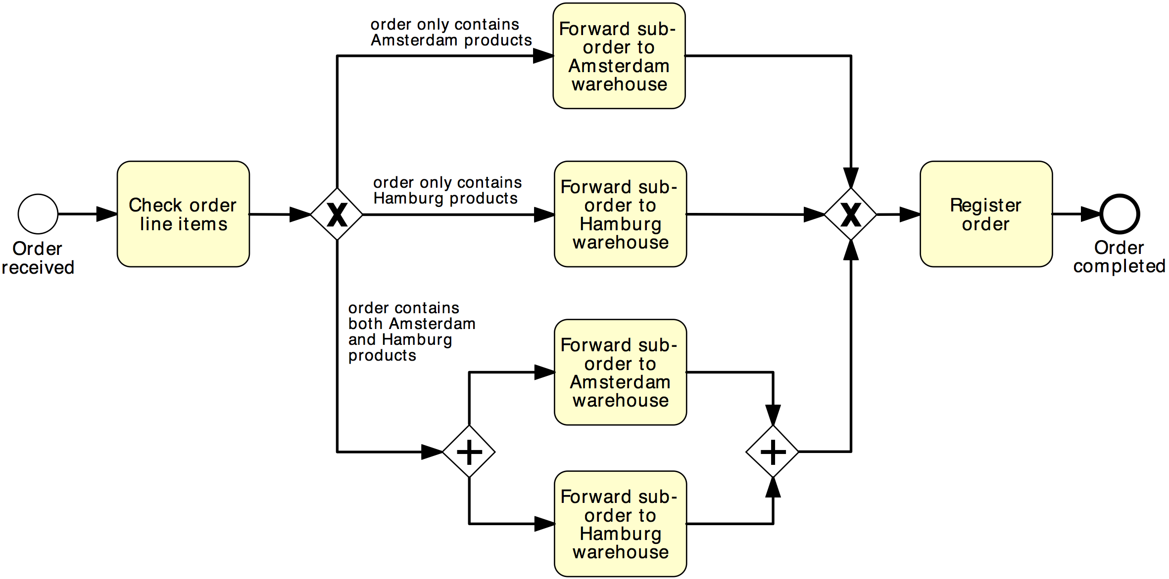
Solution 1
Order distribution process
XOR-split
XOR-join
AND-split
AND-join

Slide 27
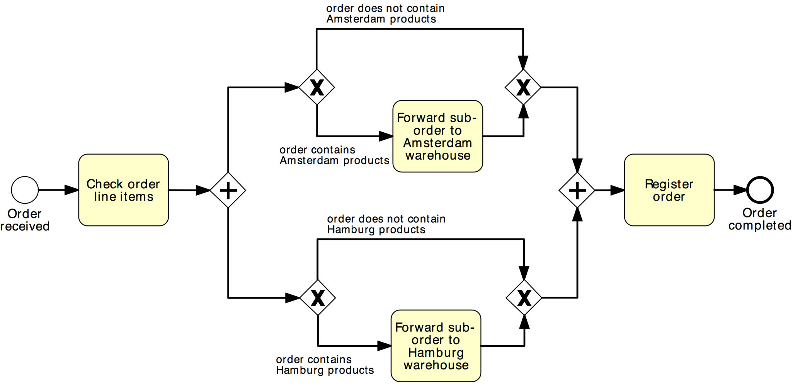
Solution 2
Order distribution process
AND-split
AND-join
XOR-split
XOR-join

Slide 28
OR Gateway
An OR Gateway provides a mechanism to create and synchronize n out of m parallel flows.
OR-split ➔ takes one or more branches depending on conditions
OR-join ➔ proceeds when all active incoming branches have completed
Notes:
By “parallel” we intend flows which can proceed indipendendly of each other
For OR-join make difference with AND-join: “active”

Slide 29
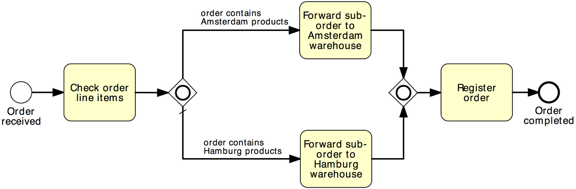
Solution using OR Gateway
Order distribution process
OR-split
OR-join
Notes:
Similar to the XOR-split, the OR-split can be equipped with a default flow which is taken if the conditions on all other branches are false

Slide 30
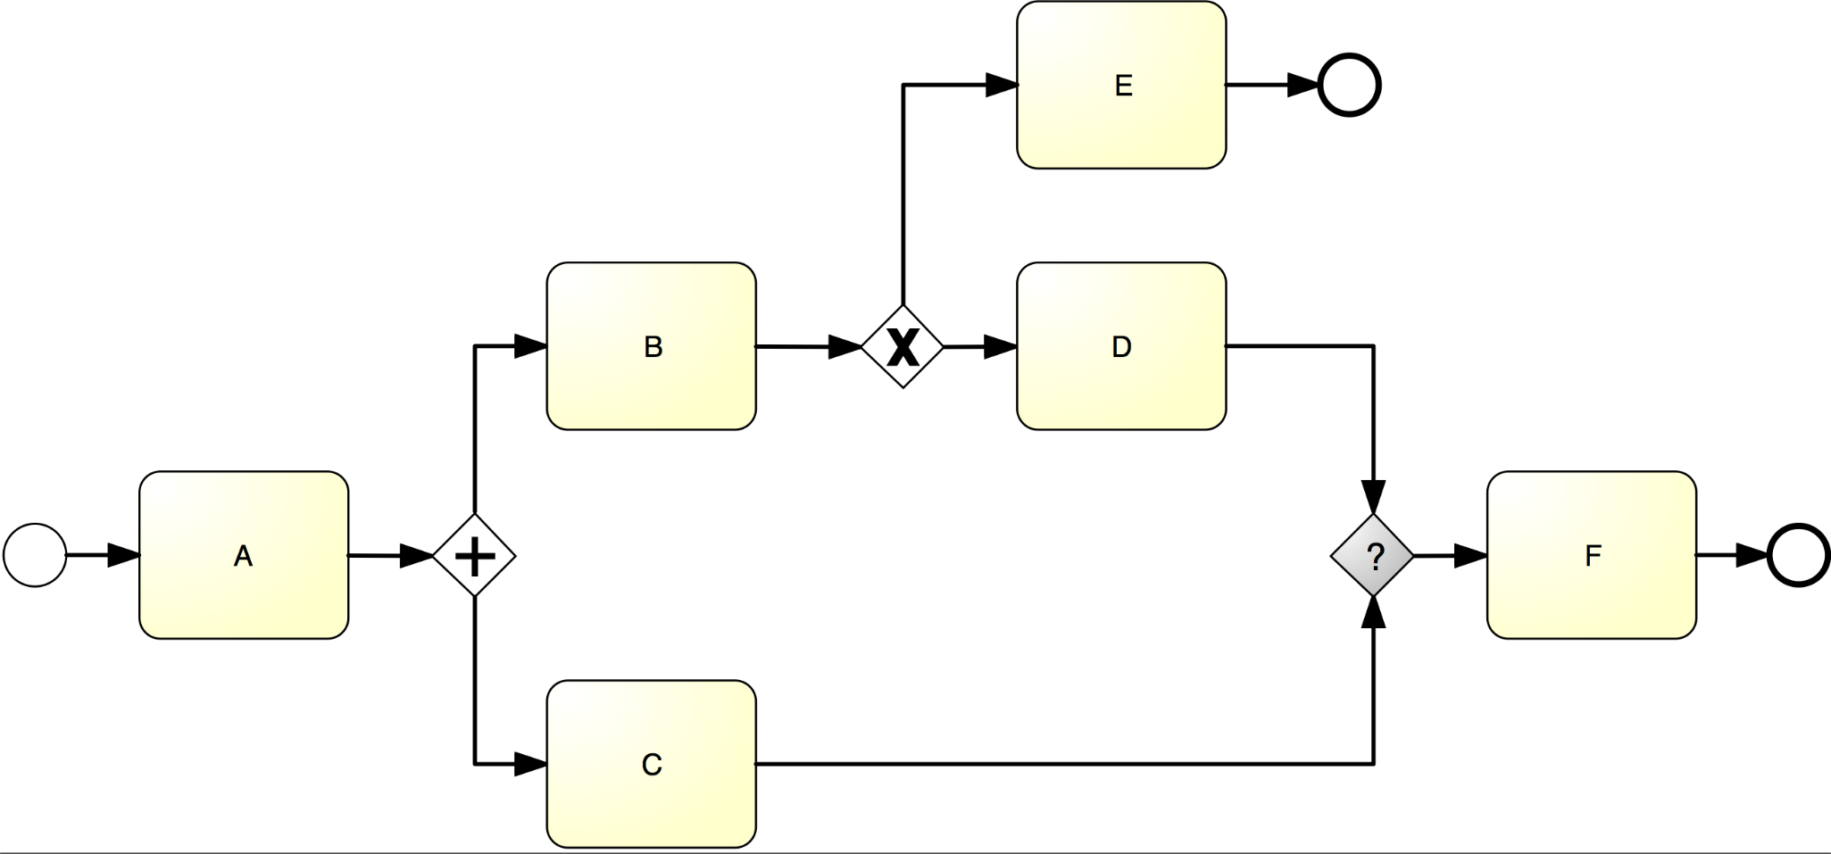
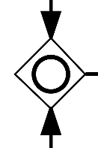
What join type do we need here?

Slide 31

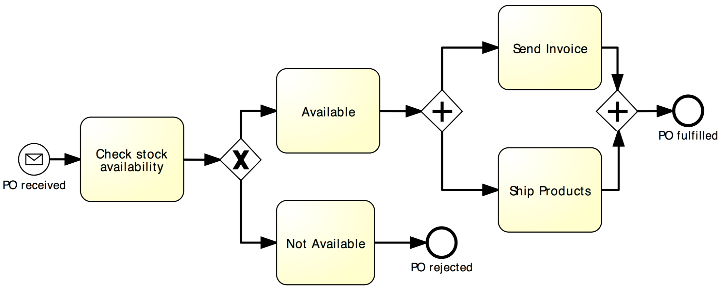
Beware: Beginner’s Mistake…
Notes:
It is worth emphasizing here that activities located in two parallel paths do not need to be performed simultaneously. For example, “Send invoice” and “Ship goods” need not occur both at the same time, although due to a cosmic coincidence, they could happen at the same time. Instead, it might happen that first the invoice is sent and later the goods are shipped. Or things may happen in the reverse order.

Slide 32
Guidelines: Naming Conventions
Give a name to every event and task
For tasks: verb followed by business object name and possibly a complement
Issue Driver Licence, Renew Licence via Agency
For message events: object + past participle
Invoice received, Claim settled
Avoid generic verbs such as Handle, Record…
Label each XOR-split with a condition
Policy is invalid, Claim is inadmissible

Slide 33
Poll: Which model do you prefer?
Notes:
This one can be restructured

Slide 34
One more guideline…
Model in blocks
Pair up each AND-split with an AND-join and each XOR-split with a XOR-join, whenever possible
Exception: sometimes a XOR-split leads to two end events – different outcomes (cf. order management example)

Slide 35
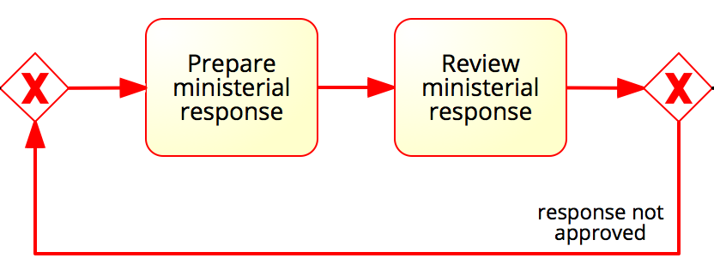
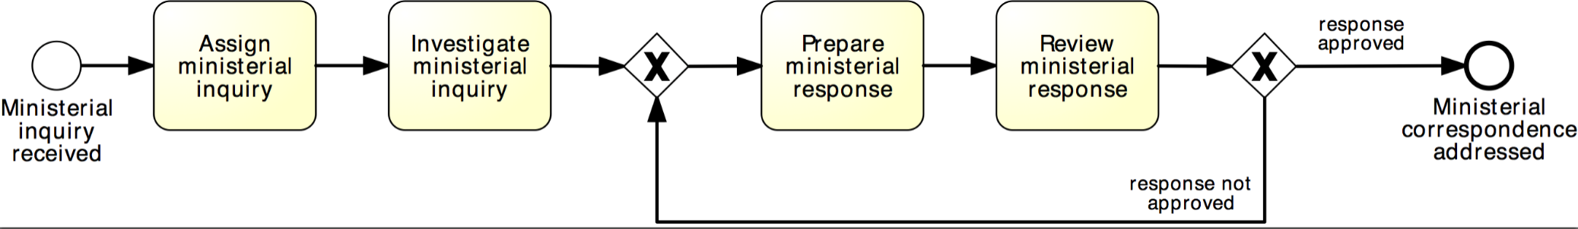
Rework and repetition
Address ministerial correspondence
In the minister’s office, when a ministerial inquiry has been received, it is registered into the system. Then the inquiry is investigated so that a ministerial response can be prepared.
The finalization of a response includes the preparation of the response itself by the cabinet officer and the review of the response by the principal registrar. If the registrar does not approve the response, the latter needs to be prepared again by the cabinet officer for review. The process finishes only once the response has been approved.
XOR-join: entry point
XOR-split: exit point
Notes:
So far we have seen structures that are linear, i.e., each activity is performed at most once. However, sometimes we may require to repeat one or several activities, for instance because of a failed check.
Repetition block, a block between an XOR-join (entry point) and an XOR-split (exit point), where the last activity is a decision activity, that allows us to repeat the block or get out of the block.
A cycle is a flow that goes back to an “earlier” point of the process. It is used to model parts of the process that can be repeated.

Slide 36
Quick Note: Implicit vs. explicit gateways
Notes:
https://www.visual-paradigm.com/guide/bpmn/bpmn-gateway-types/

Slide 37
How this process starts? How it ends?
Notes:
Also point to the two triggers (new mail and new email).

Slide 38
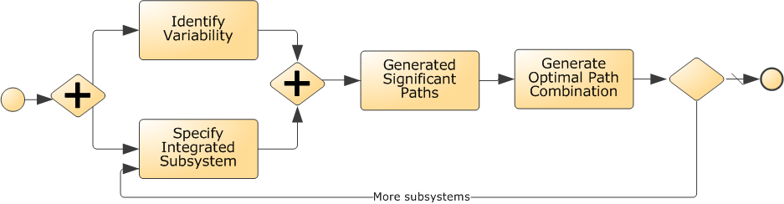
What’s wrong with this model? How to fix it?
X

Slide 39
Process Modelling Viewpoints
Organization
Who?
Lanes &
Pools
What?
Tasks
Events
When?
Flows
Gateways
Which?
Data Objects, Stores
Data / Materials
Notes:
The Functional perspective, indicates What tasks/function are happening in the process?
The Control-flow perspective, indicates when should an activity be performed, that is, in what order should activities and events occur?
The resource perspective (also called organisational perspective) indicates Who performs which activity?
Finally, the data perspective indicate which data are necessary to perform each activity and which data are produced by each activity in the process?

Slide 40
Organizational Elements in BPMN – Pools & Lanes
Pool
Captures a resource class. Generally used to model a business party (e.g. a whole company)
Lane
A resource sub-class within a pool. Generally used to model departments (e.g. shipping, finance), internal roles (e.g. Manager, Associate), software systems (e.g. ERP, CRM)
Notes:
A Pool acts as the container for the Sequence Flow between activities. The Sequence Flow cannot cross the boundaries of a Pool
Lanes can be nested (e.g. an outer set of Lanes for company departments and an inner set for roles within each department)
Complement your BPMN models with organizational charts, role-responsibility matrices, RACI diagrams

Slide 41
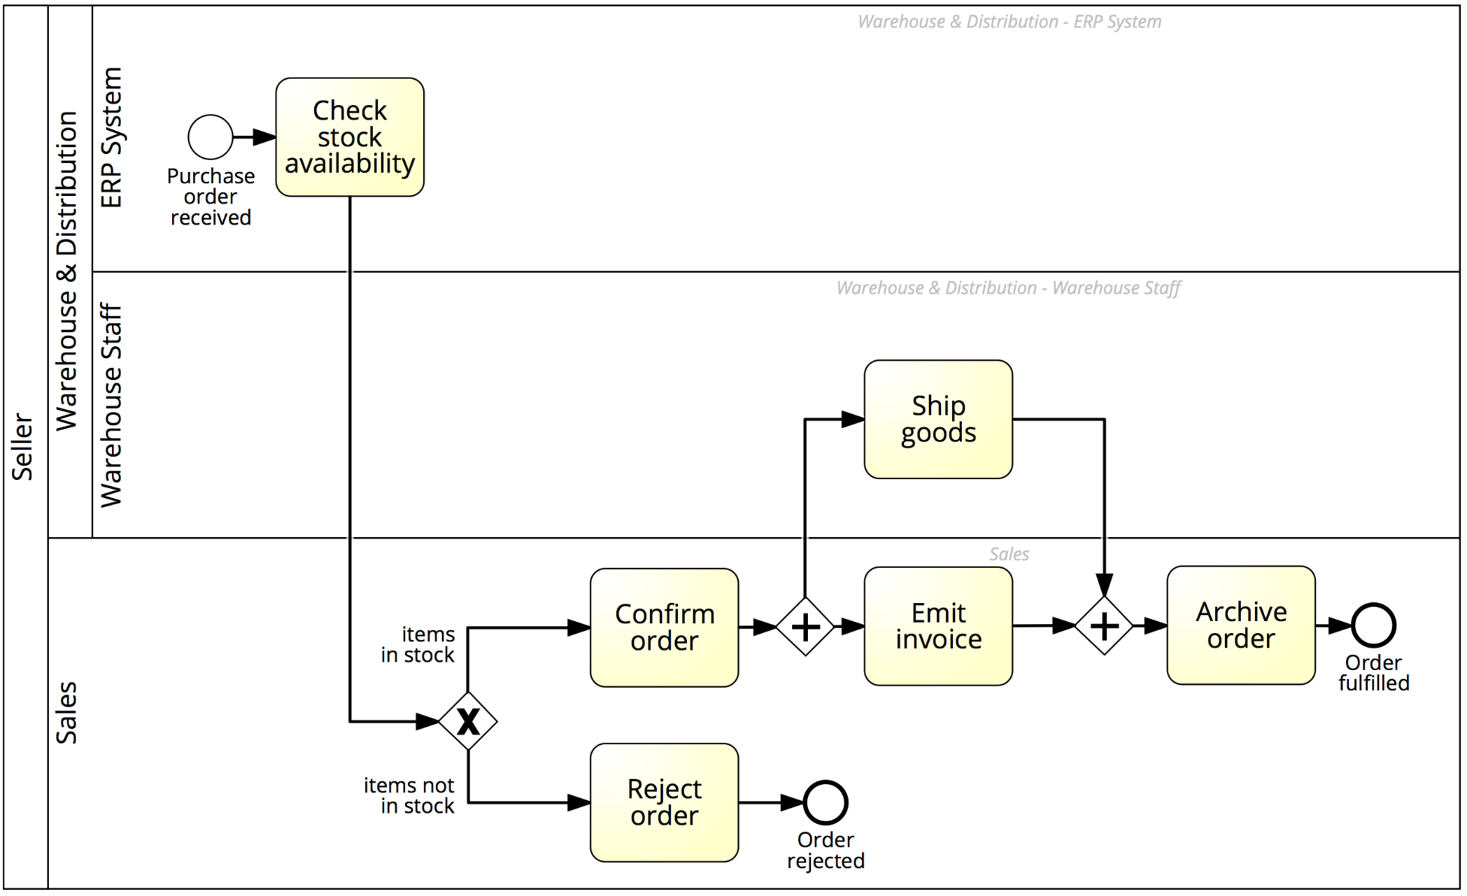


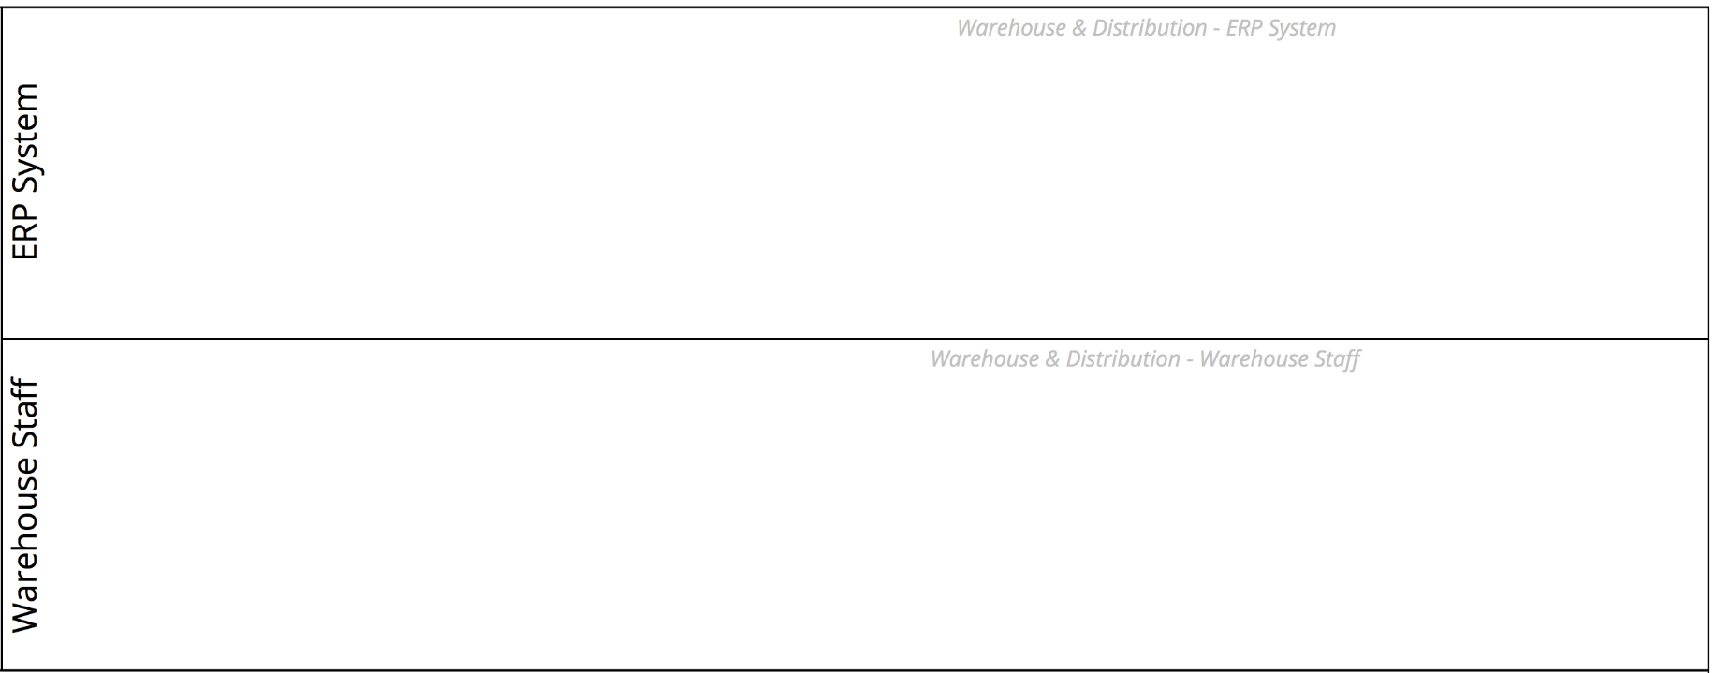
Order-to-cash process with lanes

Slide 42
Message Flow
A Message Flow represents a flow of information between two process parties (Pools)
A Message Flow can connect:
directly to the boundary of a Pool ➔ captures an informative message to/from that party
to a specific activity or event within that Pool ➔ captures a message that triggers a specific activity/event within that party
Notes:
The interaction between Pools, e.g., between two collaborating organizations, is shown through the Message Flow
Depicted by a dashed line with an open arrowhead
Describe send and receive activity and their semantics in terms of data tokens

Slide 43
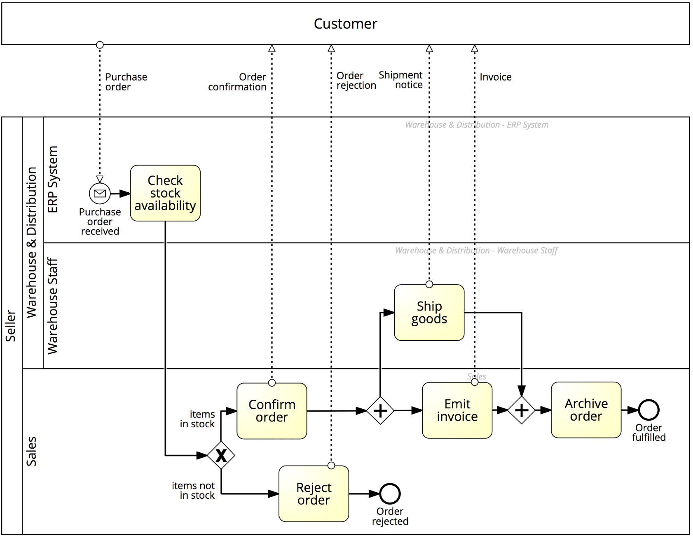


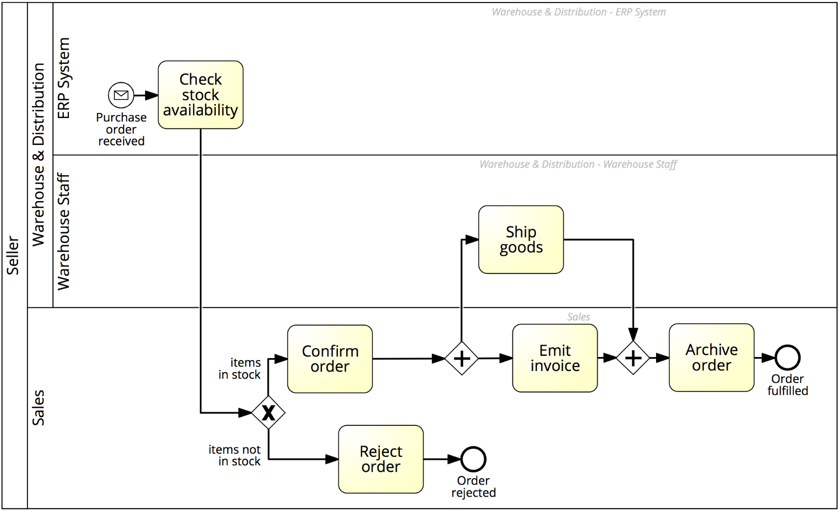
Order-to-cash process with a black-box customer pool
Notes:
Now we have all ingredients to capture our order to cash example

Slide 44
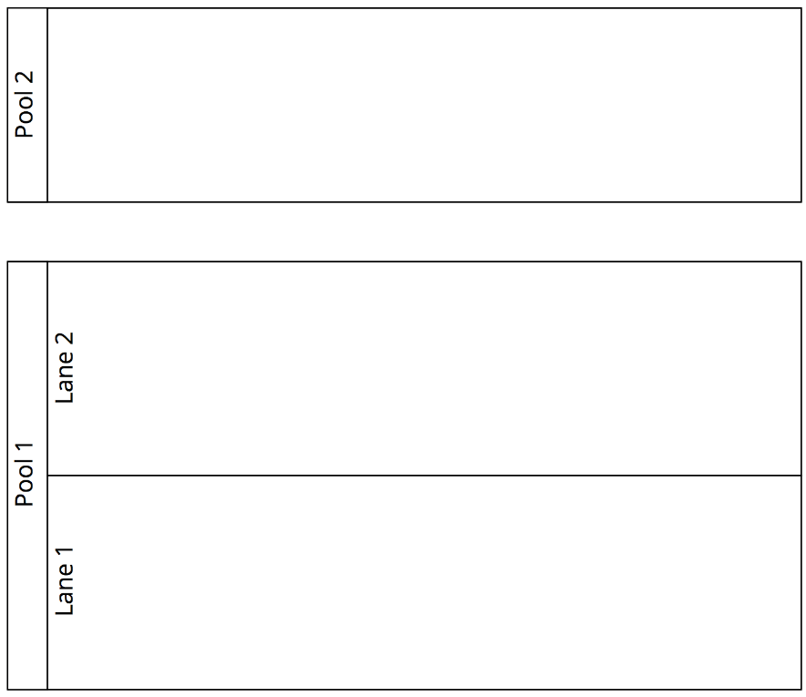
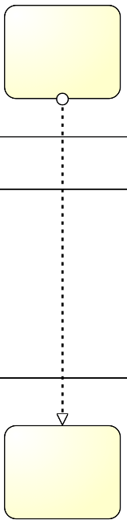

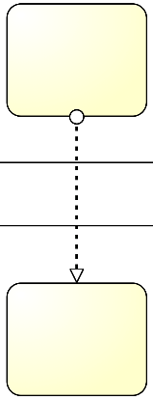


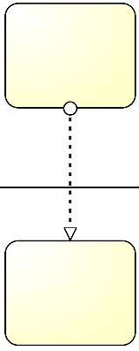
Pools, Lanes and Flows: syntactic rules
A Sequence Flow cannot cross the boundaries of a Pool (message flows can)
Both Sequence Flow and Message Flow can cross the boundaries of Lanes
A Message Flow cannot connect two flow elements within the same pool
Notes:
So to sum up,

Slide 45
One more guideline…
Start modeling with one single “white-box” pool
Initially, put the events and tasks in only one pool – the pool of the party who is running the process
Leave all other pools “black-boxed”
Once you have modeled this way, and once the process diagram inside the white-box pool is complete, you can model the details (events and tasks) in the other pools if that is useful.
In this course we will only model processes with one single white-box pool – all other pools are black-box

Slide 46
Process Modelling Viewpoints
Which?
Data Objects, Stores
Data / Materials
Notes:
The Functional perspective, indicates What tasks/function are happening in the process?
The Control-flow perspective, indicates when should an activity be performed, that is, in what order should activities and events occur?
The resource perspective (also called organisational perspective) indicates Who performs which activity?
Finally, the data perspective indicate which data are necessary to perform each activity and which data are produced by each activity in the process?

Slide 47
BPMN Information Artifacts
A Data Object captures an artifact required (input) or produced (output) by an activity.
Can be physical or electronic
A Data Store is a place containing data objects that must be persisted beyond the duration of a process instance.
It is used by an activity to store (as output) or retrieve (as input) data objects.
Notes:
Represent input and output of a process activity.
, e.g. a database for electronic artifacts or a filing cabinet for physical ones.

Slide 48
Order-to-cash process, again
The purchase order document serves as an input to the stock availability check. Based on the outcome of this check, the status of the document is updated, either to “approved” or “rejected”. If the order is approved, an invoice and a shipment notice are produced.
Notes:
Let’s have a look at some artifacts...

Slide 49
Model with information artifacts
Beware: This diagram is a too detailed. It is for illustration purposes.
In practice, try to only model the most important data objects and associations. Keep the model readable.

Slide 50
A Final Note: BPMN Text Annotations
A Text Annotation is a mechanism to provide additional text information to the model reader
Doesn’t affect the flow of tokens through the process
Notes:
Sometimes we may need to provide additional information to the process model reader, for the sake of improving the understanding of the model. For example, in the order-to-cash process we may want to specifcy that activity “Ship goods” also includes the packaging of the products. Also, we may want to clarify what business rule is followed behind the choice of suppliers or the approval of an order. All this information is provided via text annotations which do not affect the flow of the process model.
Say that in a text annotation the connection, called association in BPMN, is undirected
A text annotation is depicted as an open-ended rectangle encapsulating the text of the annotation, and is linked to a process modeling element via a dotted line

Slide 51
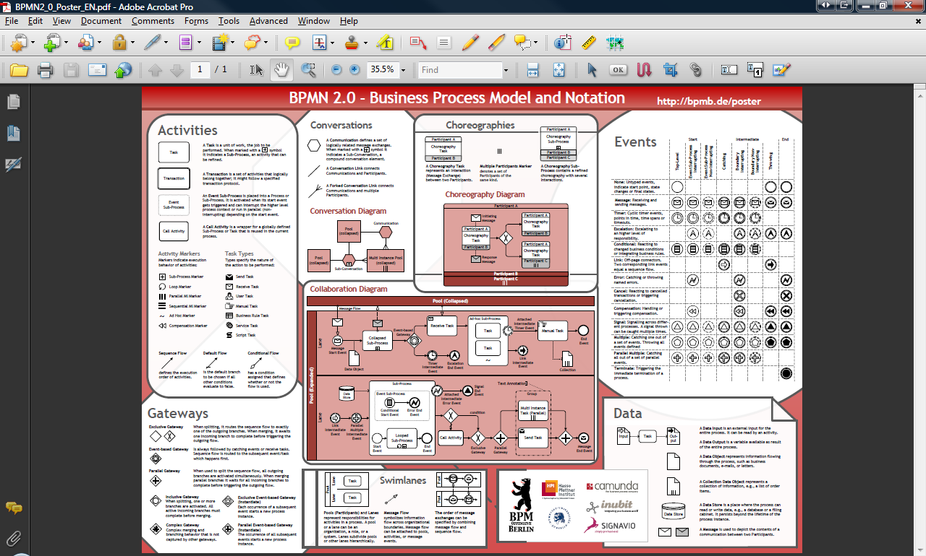
BPMN Poster (link in “Readings” page)

Slide 52
Quiz
https://www.proprofs.com/quiz-school/ugc/story.php?title=essentials-of-process-modeling

Slide 53
Readings
https://mbf-iut.i3s.unice.fr/lib/exe/fetch.php?media=2019_2020:s2:td:le_poster_bpmn_2.0_de_signavio.pdf

